Slide 1
Chain Status Modeling and Visualization
Affectus Hackathon 2018

Slide 2
Weather Crawler
NodeRed Implementation
Uses the aWhere and Darksky APIs
Collects norms about the weather conditions (temperature, wind and humidity)
Compares current (or chosen timestamp) conditions with norms
Emits relevant events (too cold, too hot, too humid, too dry e.t.c.)

Slide 3
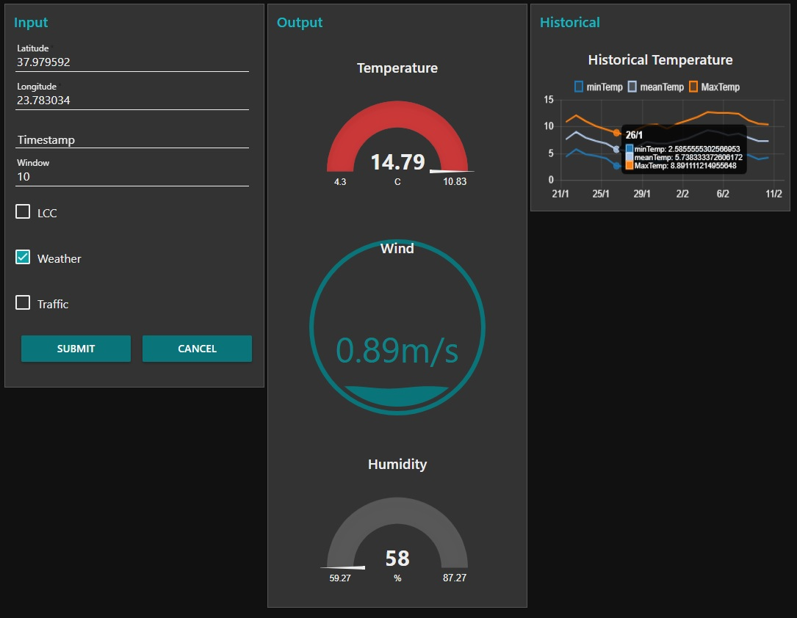
Weather Front End

Slide 4
Helper Flows
Stream Processor: Creates test streams and applies some preprocessing to all streams (data ingestion)
Delay Checker: Runs through the MongoDB data store, locates things that have surpassed the expected duration and forwards ‘delayed’ events to a web socket
Stage Identifier: Identifies the chain stage based on a scan geo-location data by cross-referencing it with the knowledge base, and adds it to the scan data stream

Slide 5
Tensor Flows
An open-source symbolic math library used for machine learning applications such as neural networks.
Tensors are multi-dimension arrays of numerals.
Supports classification, regression and clustering using linear regressors or deep neural networks.
Developed in Python.

Slide 6
Example Data
Day | Month | Chain Stage | Product ID | Thing ID | Hot or Cold | Humid or Dry | Windy | Duration
3 | 10 | 2 | 653 | 1235 | -1 | 1 | 0 | 5213
14 | 9 | 3 | 523 | 5243 | 1 | 0 | 1 | 1262
6 | 9 | 1 | 123 | 12 | 0 | 1 | 1 | 6342
10 | 7 | 1 | 63 | 532 | -1 | -1 | 0 | 123567
Example Tensor
[[3,14,6,10],[10,9,9,7],[2,3,1,1],[653,523,123,63],[1235,5243,12,532],[-1,1,0,-1],[0,1,1,0],[5213,1262,6342,123567]]

Slide 7
Affectus Chain Modeling
Python Backend for TensorFlows modeling
NodeRed front end for processing incoming data into TensorFlows and storing data
Connected by Rest API calls using HTTP Post

Slide 8
Chain Modeling Backend
Flask python server to listen for incoming model train or prediction requests
If request is train start training process and block all other incoming requests until it is completed
If request is prediction use the trained model to predict the expected duration that the Thing is supposed to remain in this chain stage
Features are parametric but some are required and some optional
Required: Thing ID, Product ID, Day, Hour, Chain Stage
Optional: Temperature, Humidity, Traffic, Wind, Month, LCC status…

Slide 9
Chain Modeling Frontend
Receives data points in JSON format, through a web socket
Processes it into the correct JSON format and makes prediction calls to the backend
If enough data points have been collected triggers a retraining to the backend
Stores the expected duration into MongoDB

Slide 10
Communication Templates
Front to Back End
Back to Front End
{"data":[{
"thing_id":644,
"product_id":2,
"data":[ {
"stage":2,
"day":5,
"hour":10,
"duration":312410322.36}]}],
"parameters":{
"retrain":false,
"refresh_data":false,
"train_file":"./scan_data/train.csv",
"model_dir":"./model_dir",
"model_parameters":{
"learning_rate":0.6}}
}
{
"predictions":{
"predictions":[[3124103.75]],
"costs":[[52.64]],
"actuals":[[312410322.36]],
"error ": "NullPointerException"},
"retrain_output":"Training already running.“
}

Slide 11
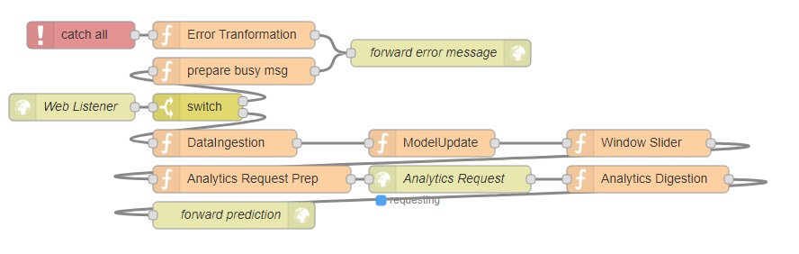

Slide 12
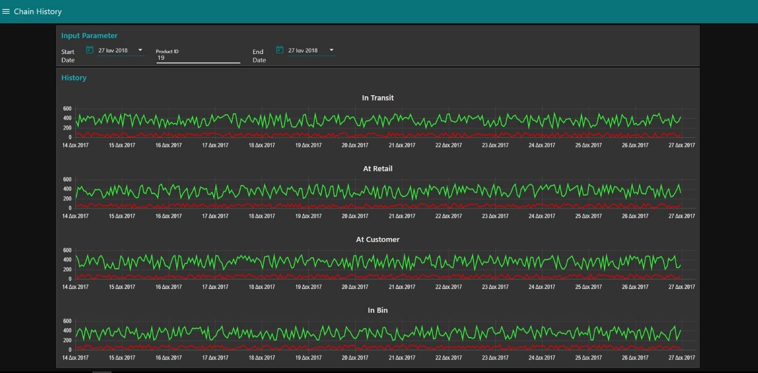
Chain Stage History Viewer

Slide 13
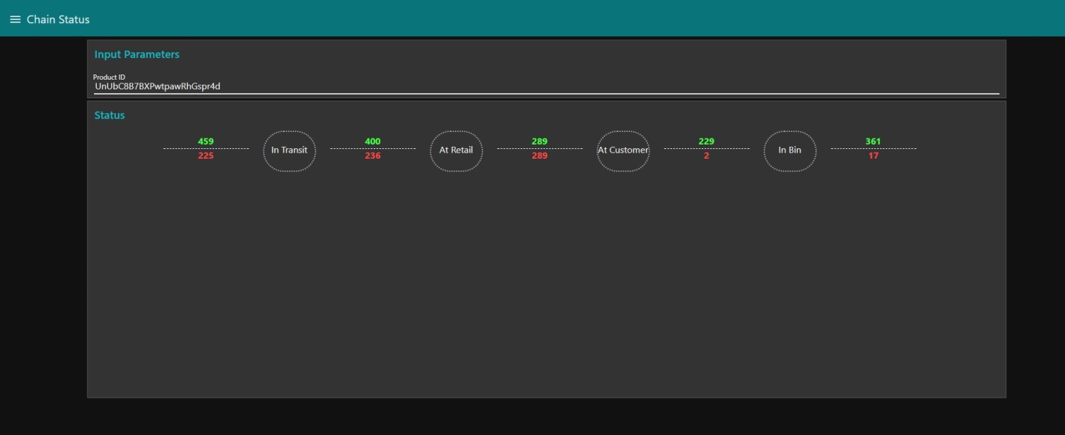
Chain Stage Live Monitoring

Slide 14
Test Data
Experimental stream created using random number generator
NodeRed flow used: Stream Processor
A new datapoint (scan) is created every 10 seconds
Each scan contains: timestamp, thing id, product id, location, stage.
The scan is forwarded to a websocket and triggers all other flows.

Slide 15
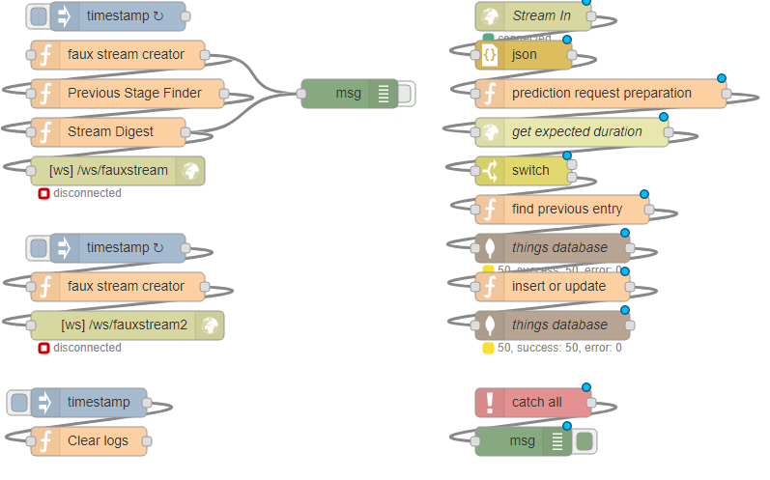

Slide 16

Questions ?

